Slide 1
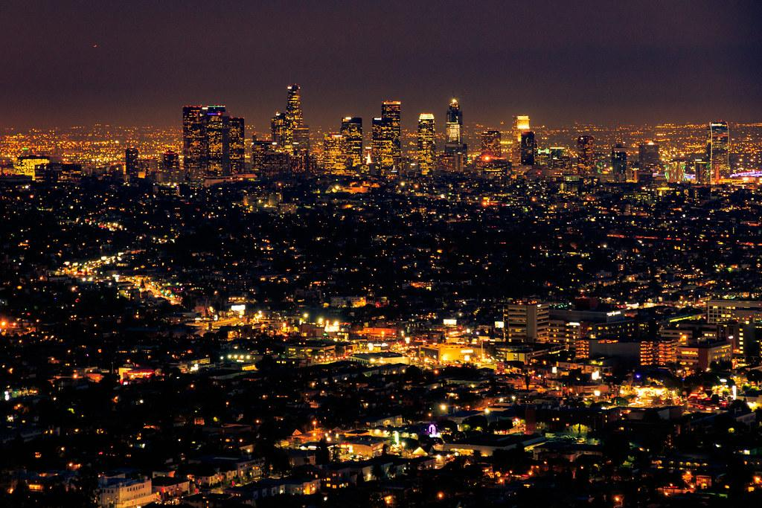
The Effect of Covid-19 on Crime in Los Angeles
Contributors: Daniel Casey, Jennifer Jones, Lisa Lonstein, Manjusha Sethi & Suman Murali
October 25, 2023

Slide 2
Objectives
Goal: To determine the potential effects of the Covid-19 pandemic on crime in the city of Los Angeles.
Research Questions:
1. Did the Covid-19 pandemic have a significant impact on overall crime?
2. Did crime shift by bureau over time?
3. Did the pandemic affect the number of victims by gender?
4. Was there was an increase in domestic violence and child abuse?

Slide 3
Hypothesis
Null Hypothesis
Annual Crime: Covid-19 did not have a significant effect on crime in Los Angeles
By Bureau: Covid-19 did not have a significant effect on crime in each area of Los Angeles
By Gender: Covid-19 did not have a significant effect on the victim gender
By Type: Covid-19 did not have a significant effect on domestic violence and child abuse
Alternate Hypothesis
Annual Crime: Covid-19 did have a significant effect on crime in Los Angeles
By Bureau: Covid-19 did have a significant effect on crime in each area of Los Angeles
By Gender: Covid-19 did have a significant effect on the victim gender
By Type: Covid-19 did have a significant effect on domestic violence and child abuse

Slide 4
Methodology
Data Sources: Reported Crime from Los Angeles Police Department, from 2010-2019 and 2020-PRESENT
Analyzed data in two stages
Stage One: Focused on the total number crimes reported, crimes reported in different areas
Stage Two: Focused on the race and/or ethnicity of the victims, a subset of the type of crime reported, and the gender of the victims

Slide 5
Data Cleaning
Steps Taken for Data Cleaning
1. Concatenated the two data sets
2. Created a “Crime Year” column to analyze crime by year
3. Removed unused columns
4. Removed NULL entries
5. Removed unrecorded victim age data
6. Renamed columns
7. Removed coordinates outside of the City of Los Angeles

Slide 6
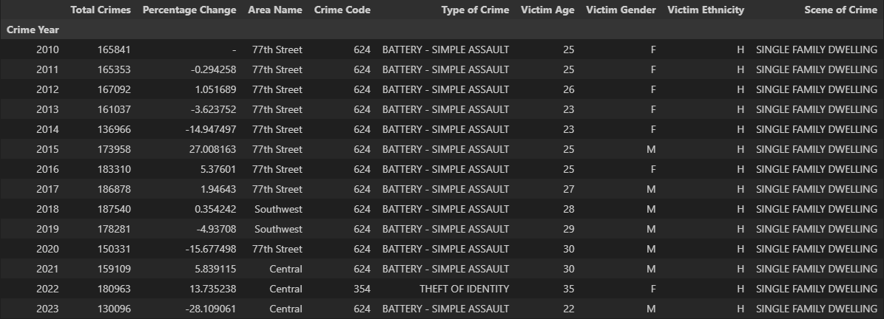
Annual Crime Analysis: Total Crime Summary

Slide 7
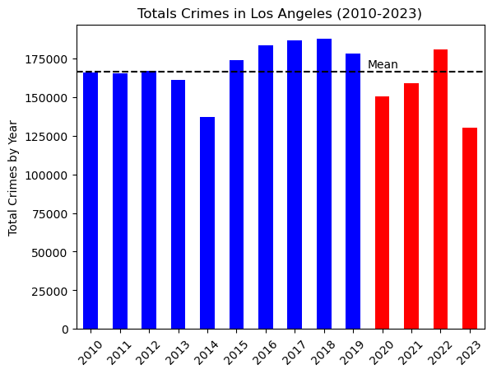
Annual Crime Analysis: Total Crimes Against the Mean
3 out of the 4 years of the Covid-19 pandemic returned less total crime than the mean.
The Pre-Covid mean was higher than the Covid-Era mean
The significance of 2013 and 2014 shows that Pre-Covid, there were still fluctuations to the total number of crimes committed in Los Angeles, as these values also fell under the mean for this timeframe.
There were no outliers from among these results.

Slide 8
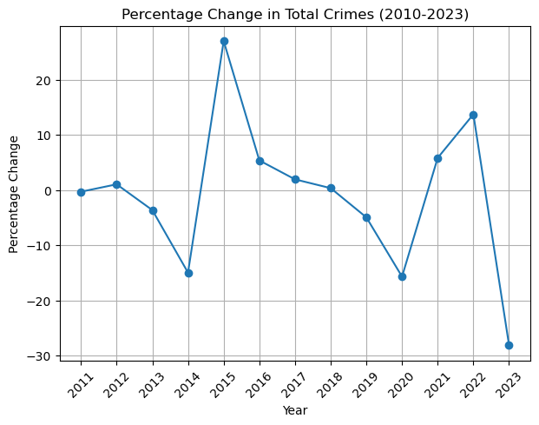
Annual Crime Analysis: Percentage Change
In 2020, total crime dropped 15.67%, which is similar to the 14.94% reduction in 2014.
During the Covid-era, crime still increased by 5.83% in 2021 and 13.73% in 2022.
It is worth nothing the 28.10% reduction in total crime in 2023 can be partially attributed to a truncated collection of data

Slide 9
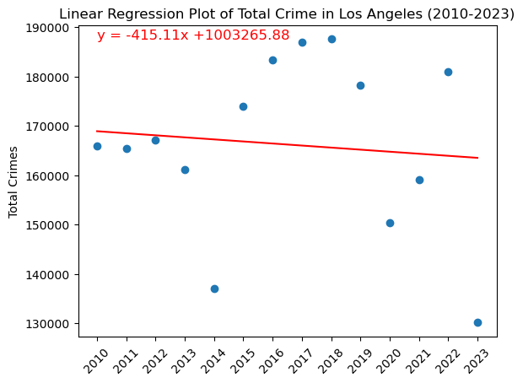
Annual Crime Analysis Hypothesis Testing
The linear regression produced an r-value of 0.0095, showing a weak linear relationship of total crimes over the years
The T-Test of the Pre-Covid and Covid-Era means produced a p-value of 0.2469
There was a 9.08% decrease from the Pre-Covid mean to the Covid-Era mean, but despite this, it is not a statistically significant difference that allows us to reject the null hypothesis.

Slide 10
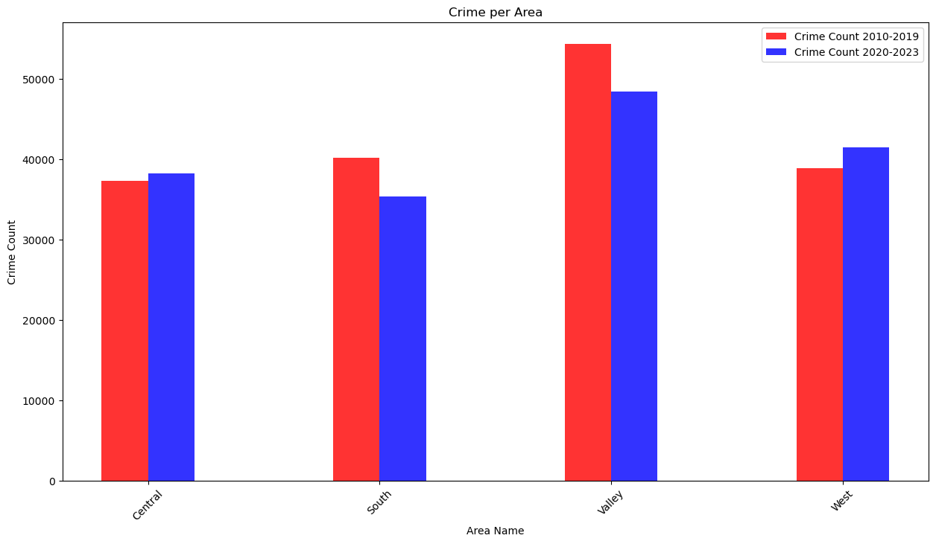
Effect of COVID in different area in Los Angeles
Total 21 Areas were part of our Data.
Divided 21 Areas into Four Bins as per LAPD Bureaus.
Central, South, West, Valley.
Calculated the mean of crimes in 4 Bureaus for Pre Covid and Covid Era.
Change in Crime over all the Areas.
Central and west had an increase in crime and South and Valley had a decrease in crime
Statistical Analysis needed to be performed.
Notes:
So We wanted to see due to COVID if crime rate in different areas in Los Angeles was affected differently. Total 21 Area. Though we saw in Bar Graph there is a decline in crimes in all areas. To further visualize it we put the data on the Map of Los Angeles.

Slide 11
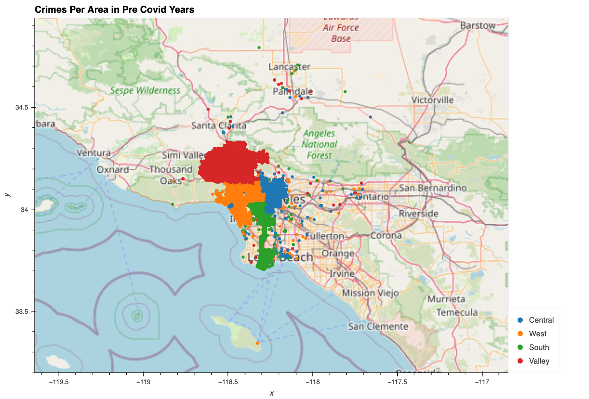
Pattern of Crimes in Four different Areas in Pre Covid Era
Bureau | Mean Crimes in Pre Covid Era
Central | 37285
South | 401884
Valley | 54326
West | 38842
Density of Crimes were high in all Areas.

Slide 12
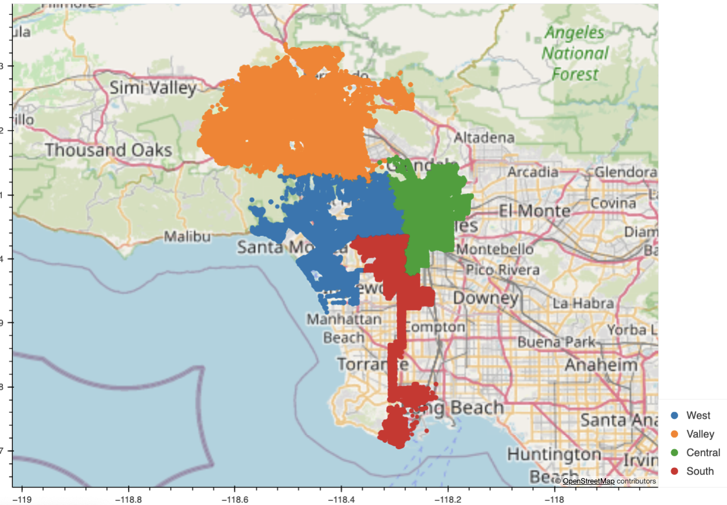
Pattern of Crimes in Four different Areas in Covid Era
Bureau | Mean Crimes in Covid Area
Central | 38260
South | 35408
Valley | 48395
West | 41450
Visually Crime density of Covid Era looks reduced
than the Pre Covid Era
Notes:
THough visually it seems like th density of crime is decreased but need further statistical testing to prove it.

Slide 13
Hypothesis Testing: Four Bureaus were affected by COVID
Null Hypothesis: There is no statistical difference between PreCovid/ Covid Crime Data in Four Bureaus
A Chi Square Test was performed to Statistically analyse the independence of two variables of Mean Crimes in 4 Bureaus for Pre CoVID and COVID Area.
p value was 1.3551948317078352e-127
P value was significantly lower than the alpha value = 0.5. So we can reject the Null Hypothesis.

Slide 14
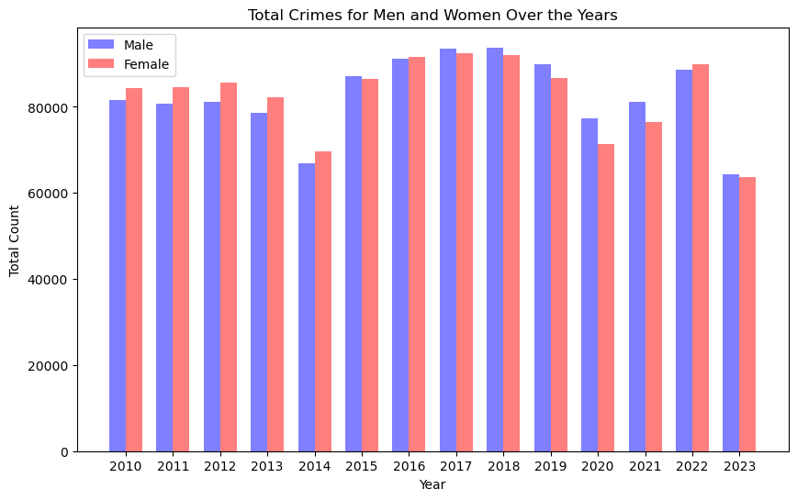
COVID effects on the total number of victims (male/female)
Based on the chart, it appears that crime for both men and women crime decreased in 2020 and increased in 2021 to 2022.
Will the t-test tell us if this is significant change?

Slide 15
Hypothesis Testing - COVID effects on victims by gender
Hypothesis: We should see a decrease in the number of total victims by gender
T-statistic (from stats): 0.024404718875823357
P-value (from stats): 0.9807161287234315
Null Hypothesis: There is no significant difference
Independent Hypothesis: There is some significant difference
RESULT OF T-TEST: Failed to reject the null hypothesis (from stats): There is no significant difference between the groups.

Slide 16
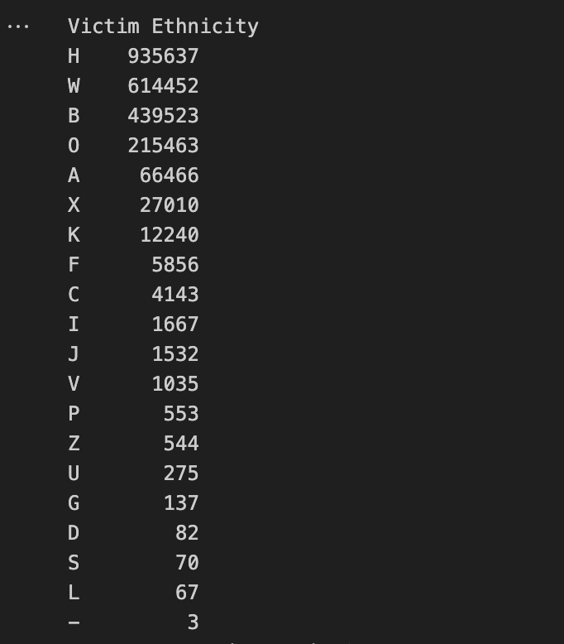
Total Crime and Victim Ethnicity
Notes:
WE compared the total crime counts and victim ethnicity. We found that the most crimes happened among Hispanic victims.

Slide 17
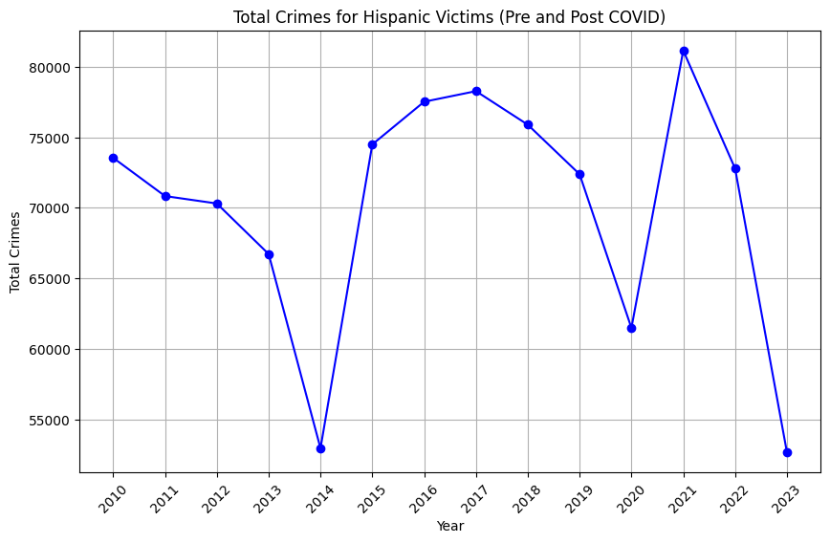
Crime Trends of Hispanic Victims
Based on the data, it is evident that the highest number of crime victims were of Hispanic ethnicity.
In 2020, the total crimes declined during COVID
Quarantine Restrictions and Regulations
Potential key indicator for total crime in LA
Follow the Annual Percent Graph on Total Crimes
Notes:
After plotting the Crime Trends on Hispanic Victims, we found it interesting that the graph is similar to the annual Crime percentage change that Daniel presented earlier.
As you can see the Crime rates decreased during COVID. This could be due to the quarantine restrictions and regulations during COVID.
It would be an potential key indicator for total crime trends in LA
However to note Although the graph shows a change during COVID, this is not a statistical relationship

Slide 18
Limitations
“ Research is like Swiss Cheese. There are always holes. We just need to figure out how big and where.”
Our Data was compiled from from hand written reports
Our assumption: COVID-19 era was in 2020
Reduction in total crime in 2023 can be partially attributed to a truncated collection of data
We did not have a key or legend to understand some of the data, like X for Gender, ages <= 0, and etc
Some of the longitude and latitude entries were not right.

Slide 19
Conclusions
Covid-19 did not have a significant effect on annual crime in Los Angeles
Covid-19 crime numbers were statistically significantly different than Pre Covid Crime numbers in Four Bureaus of Los Angeles
Covid-19 did not have a significant effect on the victim gender
Covid-19 effect on domestic violence and child abuse was not conclusive

Slide 20
Attributions
Data Set: City of LA Crime Dataset 2010 – 2019 and 2020-Present
API Used : Base Geoapify URL

Slide 21

Thank You!

